Slide 1

Savitribai Phule Pune University Third Year of Computer Engineering (310246: Skill Development Lab) Mini-Project Presentation On “College Management System” Group ID : A-17
Name of Students :
1. Chetan Pawar
2. Nishant Kumar
3. Parth Vijay
4 Nikhil Prakash
Name of Guide :
Mahesh Pawaskar
Department of Computer Engineering, MIT Academy of Engineering, Alandi(D)

Slide 2
Presentation Outline
Introduction
Problem Statement and Exiting System
Objective
Goal
Technologies/Platform Used
Project Block Diagram/ Working Model
Application
Advantages and Challenges
Future Scope
Conclusion
Department of Computer Engineering, MIT Academy of Engineering, Alandi(D)

Slide 3
Introduction
The main objective of college management system is to automate all functionalities of a college or university. Using this system you can manage all college management work like admission, fees submission, time table management and result declaration.
Using this college management system you can view or update data and information about students and staff easily. This system helps in managing the activity like student admission, student registration, fees submission.
Using this system you can manage all information of all aspects of a college, its students, faculties, Departments, marks and other curricular activities. College management system provides the easiest way to manage all functionalities of a college.
In the modern world of technology, computers are affecting our lives in more ways than we probably are aware of. COMPUTERISED MANAGEMENT, maintaining information of an educational institutes, Colleges, other the list is endless.
Department of Computer Engineering, MIT Academy of Engineering, Alandi(D)

Slide 4
Problem Statement
To develop a system that will manage
-> Information about the various users
-> Information about subjects offered in various semesters
-> Marks obtained by students in various semesters
->Generation of reports
Department of Computer Engineering, MIT Academy of Engineering, Alandi(D)

Slide 5
Existing System
Whenever we implement new system it is developed to remove the shortcomings of an existing system. The computerized has more Edge over the manual system. As we are doing a project on “COLLEGE MANAGEMENT”. So firstly we will introduce the existing system, the existing system is based on manual system, which takes lot of time to get performance of the test

Slide 6
Objectives and Goals
The main objective of developing the current project entitled “COLLEGE MANAGEMENT SYSTEM FOR COLLEGES” is to build effective system which is fast, accurate, consistency, reliable and flexible enough so that it can incorporate any future enhancements.
By automating the system using computers, sophisticated technology can be used for making the information more flexible, accurate, and secure and user friendly.
Time and man power can be more effectively utilized and online information can be easily available to the user and at the same time we can maintain higher level of security.
Every user such as student, staff and administration can able to see the information of each student through online from anywhere and anytime.
Department of Computer Engineering, MIT Academy of Engineering, Alandi(D)

Slide 7
Technologies/Platform Used
Technologies/Platform Used
JavaFX
Net Beans
Scene Builder
MySQL
etc
Department of Computer Engineering, MIT Academy of Engineering, Alandi(D)

Slide 8
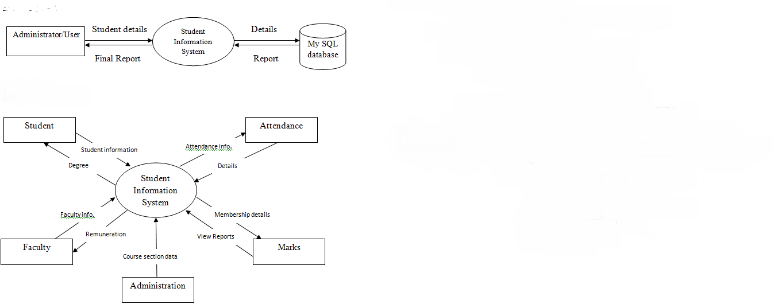
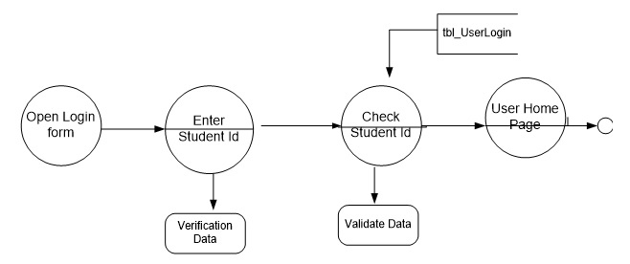
Project Block Diagram

Slide 9
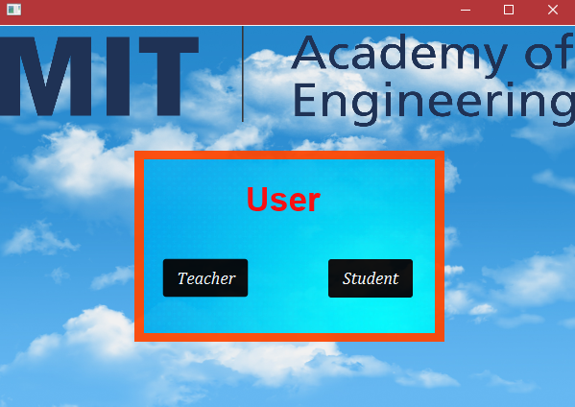
Snapshots

Slide 10
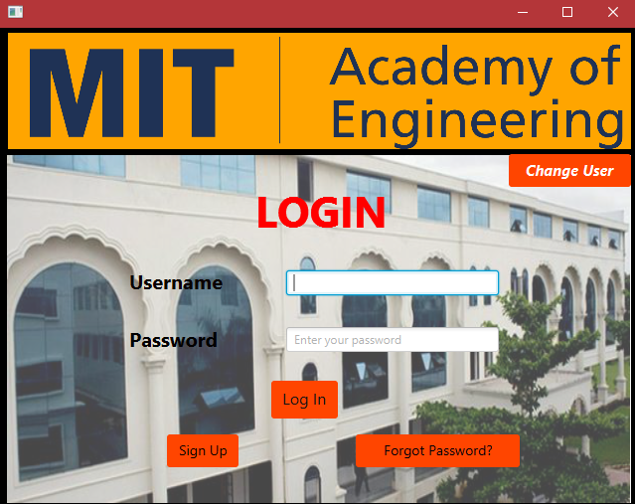
LOG IN

Slide 11
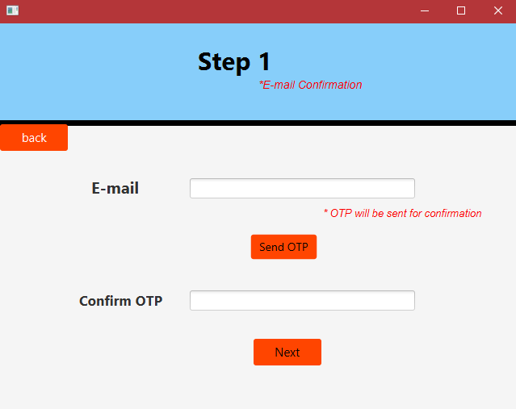
SIGN UP

Slide 12
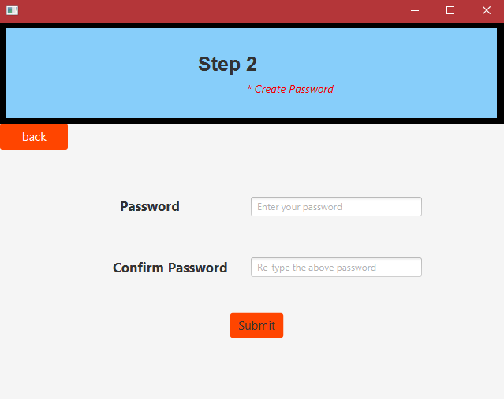
SIGNUP

Slide 13
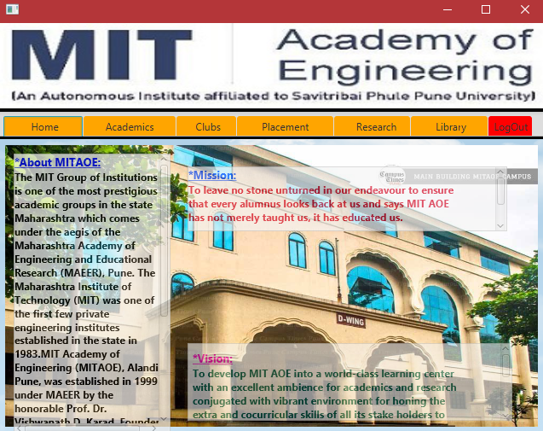
HOMESCREEN

Slide 14
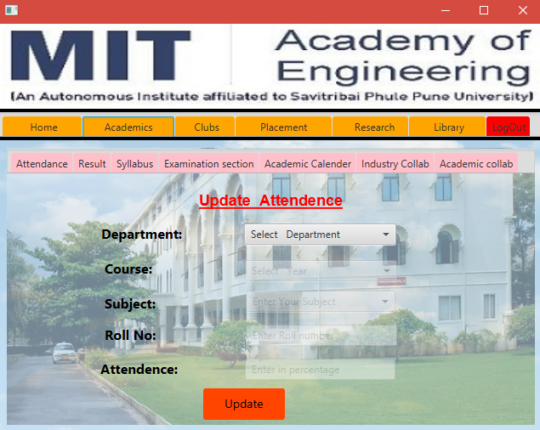
FUNCTIONS

Slide 15
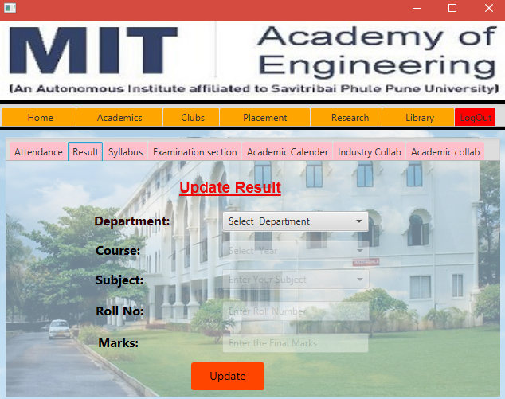
FUNCTIONS

Slide 16
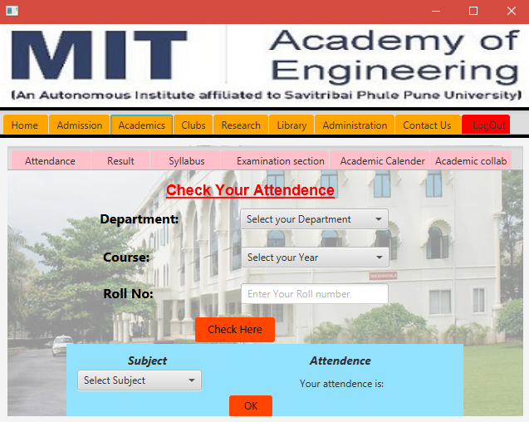
FUNCTIONS

Slide 17
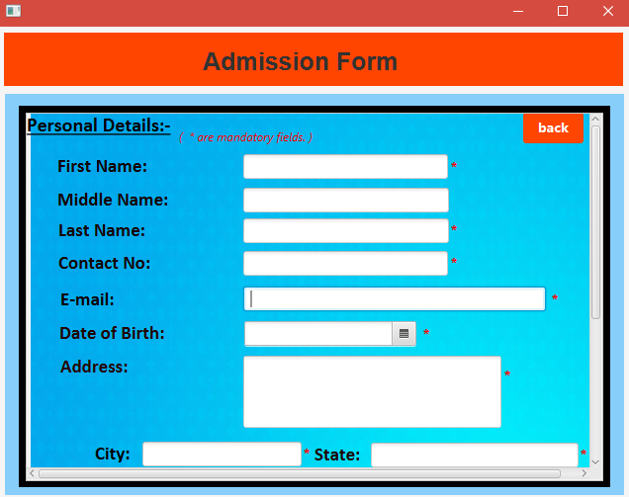
ADMISSION FORM

Slide 18
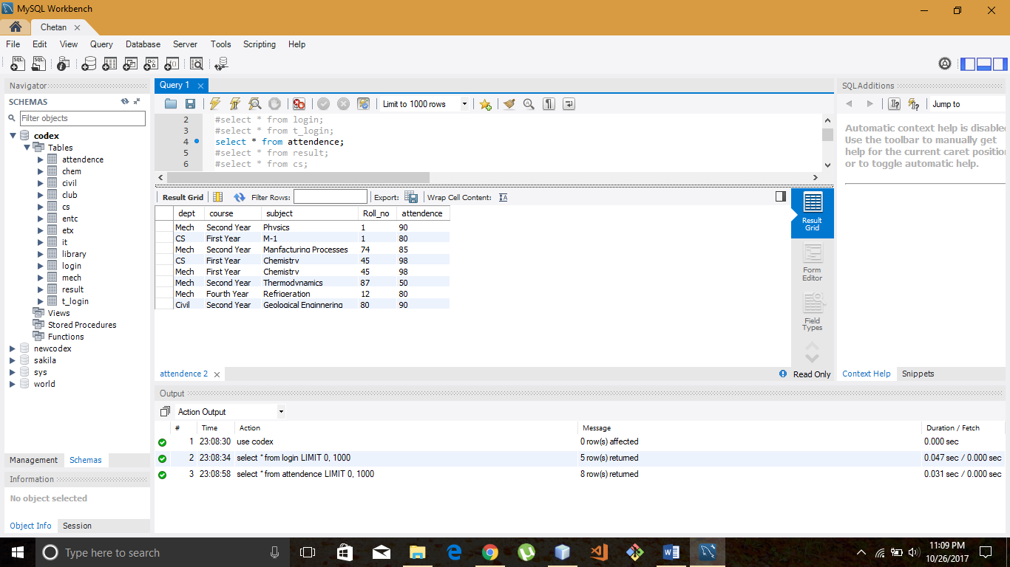
Database

Slide 19
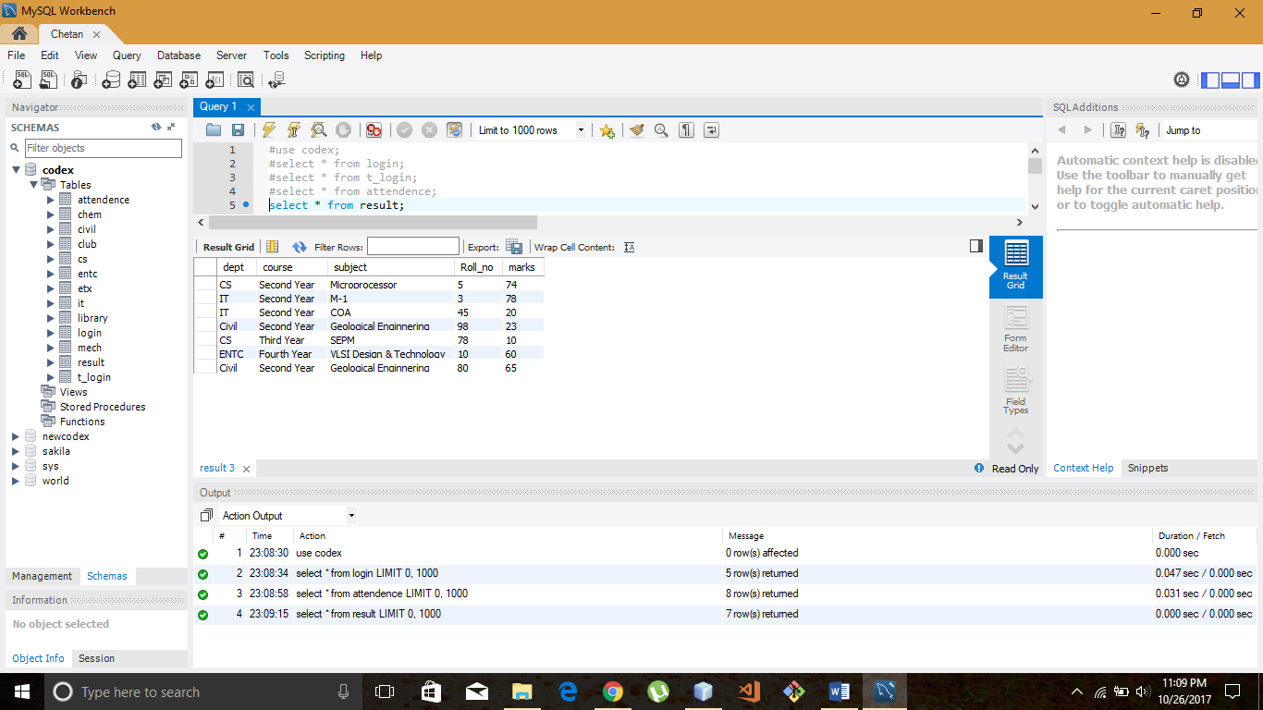
database

Slide 20
Application
The application of college management system for the employee is they can create any kind of certificate easily using this system. They can easily retrieve all information related to student and employee.
Admin has all the Collective records of students of all the branches. Admin can check all the records of employees of all departments anytime. This system gives easy approach to find the detail information for any student/employee. Using this college management system it is very easy to handle all functionality of college.
This system is beneficial for both students and employees as they can get all previous or current information when they need. This system is also helpful to maintain the students record like admission record, fees record, exam result records.
College management system can help to get all or a particular student attendance information. Also it can help to maintain the fees and accounting reports of college in proper way. This system also helps to generate mark sheets of current year.
Department of Computer Engineering, MIT Academy of Engineering, Alandi(D)

Slide 21
Advantages
These types of CMS are already available in our markets, but it does not have the feature that we are providing to our college.
Many of the companies are improving this project on the platform .NET. that seems to be complicated and to use
The main functionality such as ENTERING AND RETRIVING of the attendance in the CMS will not be provided by the companies who had developed this project earlier.
We are going to introduce our project on a special platform JAVA which is very user friendly.
This system is beneficial for both students and employees as they can get all previous or current information when they need. This system is also helpful to maintain the students record like admission record, fees record, exam result records.
College management system can help to get all or a particular student attendance information. Also it can help to maintain the fees and accounting reports of college in proper way. This system also helps to generate mark sheets of current year.
Department of Computer Engineering, MIT Academy of Engineering, Alandi(D)

Slide 22
Future Scope
The application can be easily implemented under various situations.
We can add new features as and when we require.
Reusability is possible as and when require in this application.
There is flexibility in all the modules.
Extensibility of the software.
Department of Computer Engineering, MIT Academy of Engineering, Alandi(D)

Slide 23
Conclusion
This paper presents a method for increasing information requested by students with the use of automated College Management System.In this ,instead of direct Contacting with direct Contacting with the faculty the student can directly checks the Results from the System if the student is registered in CMS.
CMIS increases quality in work for educational institutes.
The software facilitates the administrators to know the present status of a student of the college.
- The software gives the information such as student personal data, student fees details, results etc.
- Generating the print reports of student personal, fee as well as result details….
- Hence we conclude that the present system (CMS for Colleges) would definitely help the user by saving time and effort by reducing the processing time and volume of errors.
- The efficiency of the work done would be improved and work satisfaction on the part of the employees after computerization would definitely on high.
- The customer satisfaction would be definitely higher when compared to the old manual system
Department of Computer Engineering, MIT Academy of Engineering, Alandi(D)

Slide 24
Reference
www.Github.com
www.tutorialpoint.com
www.stackoverflow.com
Concept of java
Wikipedia
Mysql documentation
Department of Computer Engineering, MIT Academy of Engineering, Alandi(D)

Slide 25
Thanking You
Any Suggestion…
Department of Computer Engineering, MIT Academy of Engineering, Alandi(D)

